Slide 1
Abbreviations
Code abbrev | Model symbol | Full parameter name (fix or potentially estimate*)
delM | δ_{M} | Shape corrector (fix)
dV | d_{V} | Dry weight density (fix)
sJAm | Jª_{Am} | Area-specific assimilation rate
sJM | J^{v}_{M} | Volume-specific maintenance costs (fix)
WB0 | W_{B0} | Initial egg weight (fix)
Lwp | L^{M}_{p} | Total length at puberty (fix)
yAV | y_{AV} | Yield of assimilates on volume, i.e. starvation
yBA | y_{BA} | Yield of egg buffer on assimilates, i.e. reproduction
yVA | y_{VA} | Yield of structure on assimilates, i.e. growth
kappa | κ | Allocation fraction to soma (fix)
f | f | Scaled food level (fix)
fB | f_{B} | Scaled food level, embryo (fix)
Lwf | L_{f}? | Half-saturation total length (fix)
mu_emb | h_{emb} | Mortality rate for embryos, i.e. hazard rate?
mu_lar | h_{lar} | Mortality rate for larvae, i.e. hazard rate?
*Fix the value if data available to calculate or standard value is good (e.g. kappa)

Slide 2
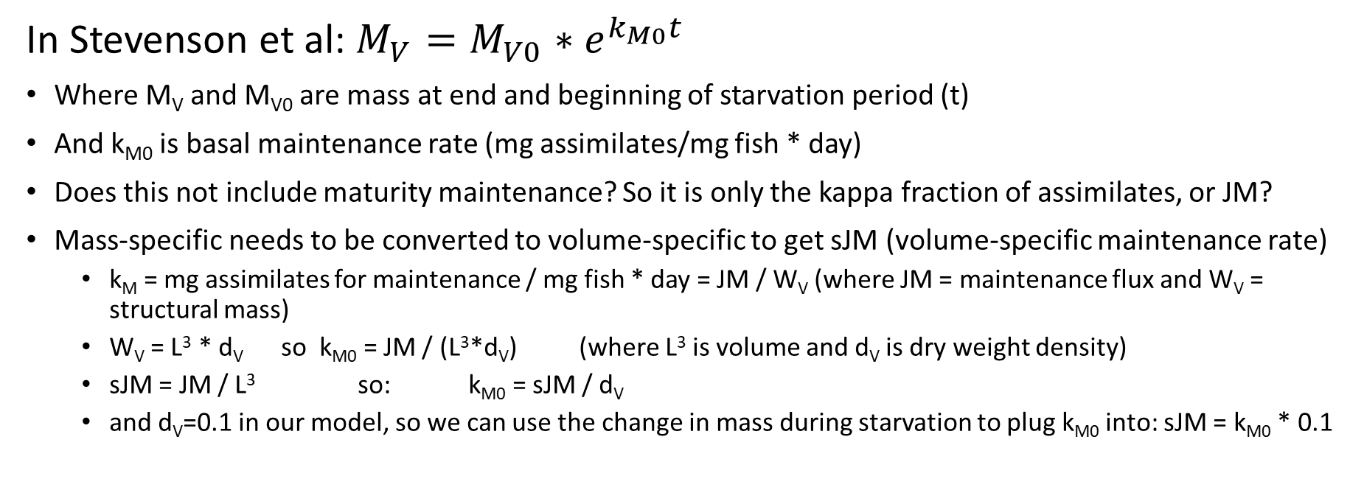
Getting Maintenance from Starvation
In Stevenson et al: $M_{V}=M_{V0}{∗e}^{k_{M0}t}$
Where M_{V} and M_{V0} are mass at end and beginning of starvation period (t)
And k_{M0} is basal maintenance rate (mg assimilates/mg fish * day)
Does this not include maturity maintenance? So it is only the kappa fraction of assimilates, or JM?
Mass-specific needs to be converted to volume-specific to get sJM (volume-specific maintenance rate)
k_{M} = mg assimilates for maintenance / mg fish * day = JM / W_{V} (where JM = maintenance flux and W_{V} = structural mass)
W_{V} = L³ * d_{V} so k_{M0} = JM / (L³*d_{V}) (where L³ is volume and d_{V} is dry weight density)
sJM = JM / L³ so: k_{M0} = sJM / d_{V}
and d_{V}=0.1 in our model, so we can use the change in mass during starvation to plug k_{M0} into: sJM = k_{M0} * 0.1

Slide 3
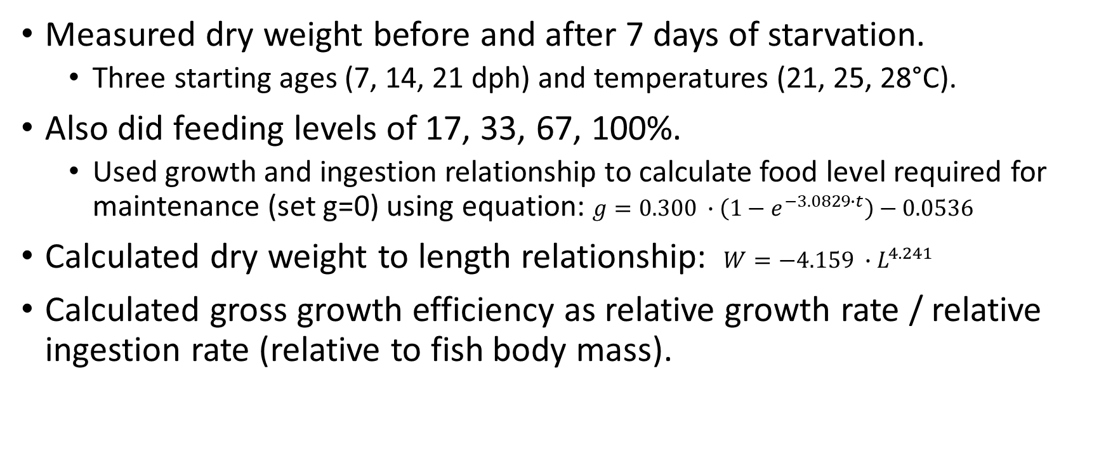
Letcher and Bengtson (1987) – Starvation, feeding rations, growth efficiency of M. beryllina ELS
Measured dry weight before and after 7 days of starvation.
Three starting ages (7, 14, 21 dph) and temperatures (21, 25, 28°C).
Also did feeding levels of 17, 33, 67, 100%.
Used growth and ingestion relationship to calculate food level required for maintenance (set g=0) using equation: $g=0.300 ∙\left(1−e^{−3.0829∙t}\right)−0.0536$
Calculated dry weight to length relationship: $W=−4.159 ∙L^{4.241}$
Calculated gross growth efficiency as relative growth rate / relative ingestion rate (relative to fish body mass).

Slide 4
Letcher and Bengtson (1987) – Starvation, feeding rations, growth efficiency of M. beryllina ELS
I extracted from plots the dry weights before and after starvation period to calculate change in weight per day at each temperature and age.

Slide 5
Letcher and Bengtson (1987) – Starvation, feeding rations, growth efficiency of M. beryllina ELS
Also plotted dry weight over time. Since there are only two time points it may be hard to estimate shape parameters of this relationship if assume nonlinear (i.e. in Stevenson et al. this was assumed to be exponential).
Note: y-axes are on different scales

Slide 6
Letcher and Bengtson (1987) – Starvation, feeding rations, growth efficiency of M. beryllina ELS
Which age(s) and temperature(s) to use to calculate sJM? 21 and 25°C are closest to most of the other data.
Should we assume linear, exponential, or something else for estimating maintenance rate from starvation weight change?

Slide 7
Correlations of all pairs of parameters

Slide 8
Current version of DEBkiss model
 | Initial parameters | Parameters estimated from ODE | Notes AIC = 390.22 (compared to 539 with fitting turned off) Negative log likelihood = 192.11 (compared to 268.586 with fitting turned off) Data used: -Total length over time -Cumulative reproduction over time -Survival over time (early life only) -Egg buffer mass: initial and at hatching Comments -fB still has the greatest effect on AIC -’Manual’ fitting focused on just first 100 days changed best initial values for sJAm, yVA, kappa, and mu_lar.
delM | 0.1066 (data) | -
dV | 0.1 | -
sJAm | 0.25 | -
sJM | 0.015 | -
WB0 | 0.15 (data) | -
Lwp | 115 (data) | -
yAV | 0.8 | -
yBA | 0.95 | -
yVA | 0.13 | 0.1404
kappa | 0.8 | 0.7622
f | 1 (ad libitum) | -
fB | 0.9 | 0.9589
Lwf | 0 | -
mu_emb | 0.07 | -
mu_lar | 0.02 | -

Slide 9
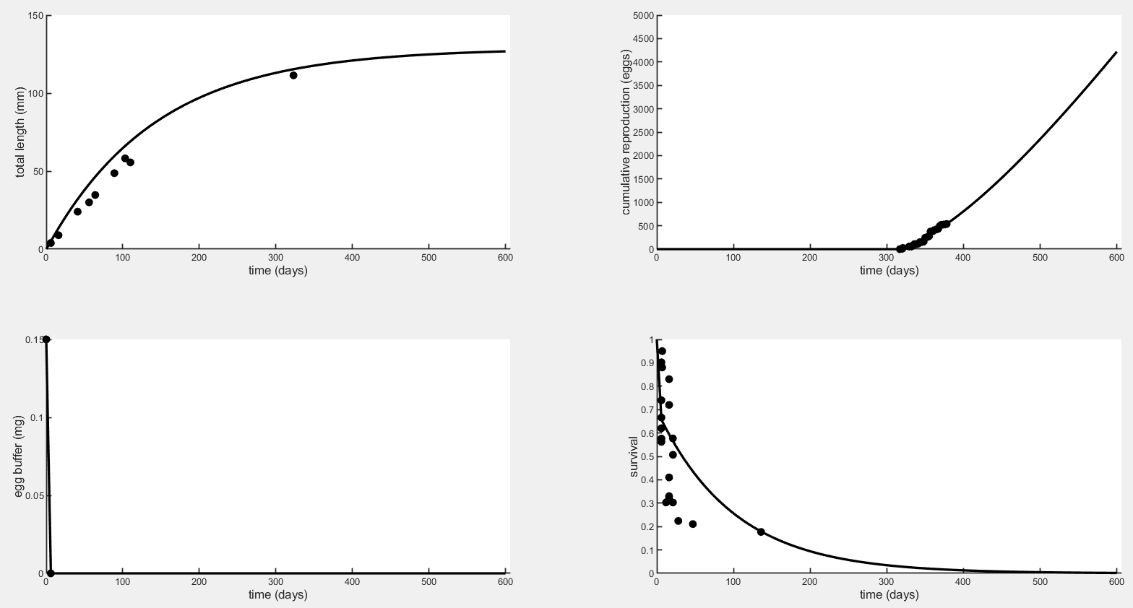
Plot to 600 days

Slide 10
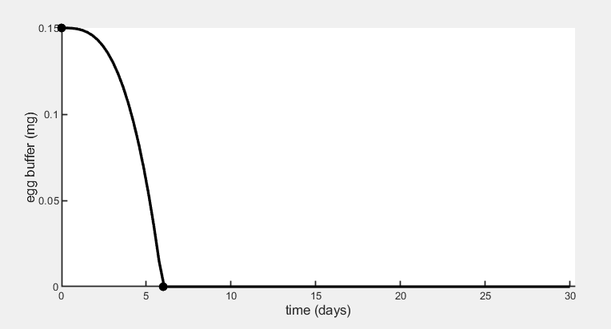
Plot to 50 days for Egg Buffer

Slide 11
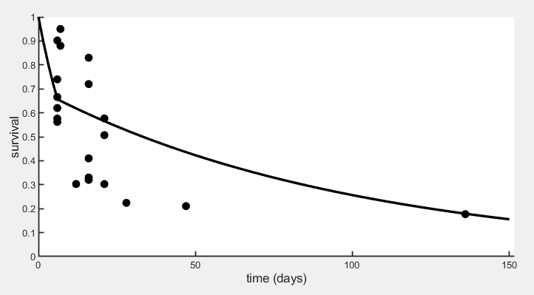
Plot to 150 days for Survival

Slide 12
Fitting for one parameter at a time, recording the estimate, AIC, and NLL below.
 | Initial parameters | Parameters estimated from ODE | AIC | Negative Log-Likelihood | Notes
delM | 0.1066 (data) | -
dV | 0.1 | -
sJAm | 0.27 | 0.2705 | 530.48 | 264.24 | Repro improved
sJM | 0.015 | 0.01497 | 530.38 | 264.19 | Repro improved
WB0 | 0.15 | 0.1345 | 523.46 | 260.73 | Repro higher
Lwp | 115 (data) | 114.8 | 530.93 | 264.46 | Repro improved
yAV | 0.8 | 1.6e-15 | 538.16 | 268.08 | Egg depletion incr
yBA | 0.95 | 1.000 | 529.21 | 263.60 | Repro hi like WB0
yVA | 0.15 | 0.1513 | 531.76 | 264.88 | Repro improved, egg depletion incr
kappa | 0.75 | 0.7514 | 531.09 | 264.54 | Repro improved
f | 1 (ad libitum) | 1.002 | 530.68 | 264.34 | Repro improved
fB | 0.9 | 0.9284 | 429.39 | 213.69 | Egg buf, surv chg
Lwf | 0 | 0.000 | 539.17 | 268.59 | Nothing changed
mu_emb | 0.07 | 0.07712 | 538.84 | 268.42 | Hatch surv lower
mu_lar | 0.01 | 0.02733 | 534.57 | 266.29 | Larval surv lower
For reference: with no fitting or parameter estimation, only ‘manual’ fitting (selection of initial parameters): NLL=268.586 (AIC not stated but I guess it is ~537).

Slide 13
Fitting for one parameter at a time, recording the estimate, AIC, and NLL below.
Here are the same parameters and AIC values but listed in order of lowest AIC (best fit, greatest improvement from version with fitting turned off) to highest:
Parameter | AIC | Notes
fB | 429.39 | Egg buffer depleted faster, survival changed slightly
WB0 | 523.46 | Reproduction higher overall
yBA | 529.21 | Reproduction higher overall, similar to WB0 effect
sJM | 530.38 | Reproduction fit improved
sJAm | 530.48 | Reproduction fit improved
f | 530.68 | Reproduction fit improved but estimate is unrealistic
Lwp | 530.93 | Reproduction fit improved
kappa | 531.09 | Reproduction fit improved
yVA | 531.76 | Reproduction fit improved, egg buffer depleted faster until last bit
mu_lar | 534.57 | Larval survival is lower, poor fit to the data point at 136 days
yAV | 538.16 | Egg buffer depleted faster, estimate is basically zero
mu_emb | 538.84 | Hatch survival is lower, about 0.6
Lwf | 539.17 | Nothing changed
For reference: with no fitting or parameter estimation, only ‘manual’ fitting (selection of initial parameters): NLL=268.586 (AIC not stated but I guess it is ~537).

Slide 14
Using the most influential parameters, fitting for combinations of two
Included: fB, yVA, kappa, sJM, sJAm, yBA (wasn’t included in last version)
Best (or most influential) pairs and their respective AIC values:
kappa & sJAm – 390.38
fB & sJM – 407.40
fB & kappa – 413.42
fB & sJAm – 413.91
fB & yBA – 417.53
fB & yVA – 418.80
fB, sJAm, and kappa had overall the biggest effect on fit.
Didn’t include WB0, Lwp, or f in this exercise because they are known values (length at puberty and initial egg weight come from literature and ad libitum food f=1).
There is a table of all combinations (not included here) if we want to look at this more.

Slide 15
Using the most influential parameters, fitting for combinations of three
 | Initial parameters | Parameters estimated from ODE | AIC | Negative Log-Likelihood | Notes
sJAm | 0.27 | 0.2720 | 408.90 | 201.45 | Looks similar to original, good fit
fB | 0.9 | 0.9253
kappa | 0.75 | 0.7455
sJAm | 0.27 | 0.2931 | 393.00 | 193.50 | Repro steeper but not unrealistic
yVA | 0.15 | 0.1518
kappa | 0.75 | 0.6864
fB | 0.9 | 0.9589 | 390.22 | 192.11 | Looks similar to original, repro slightly steeper
yVA | 0.15 | 0.1404
kappa | 0.75 | 0.7622
sJAm | 0.27 | 0.2714 | 410.29 | 202.14 | Looks very similar to first combo and original
fB | 0.9 | 0.9355
yVA | 0.15 | 0.1471
Used best three from the previous exercise, and included yVA because we are interested in the conversion efficiency for hypoxia.
Best combination (lowest AIC) is fB, yVA, and kappa.
Followed closely by sJAm, yVA, and kappa.

Slide 16
Best combination (lowest AIC) is fB, yVA, and kappa.

Slide 17
The slides after this one are unchanged from previous update.

Slide 18
Other updates
Working on using log-transformed survival
Still need to get more info about transient spike in metabolism at low oxygen.

Slide 19
Hypoxia effects on metabolism
P_{crit} by stage (ambient CO₂ group, no acidification):
Embryo: 2.044(±0.209) mg/L
2 days-post-hatch: 1.653(±0.154) mg/L
5 days-post-hatch: 1.561(±0.183) mg/L
Some embryos had no identifiable P_{crit}, fully oxygen-dependent (or oxyconforming)
Many individuals, especially larvae, showed a brief spike in oxygen consumption at very low O₂, likely due to stimulatory effects of anaerobic byproducts building up (lactate, etc.)

Slide 20
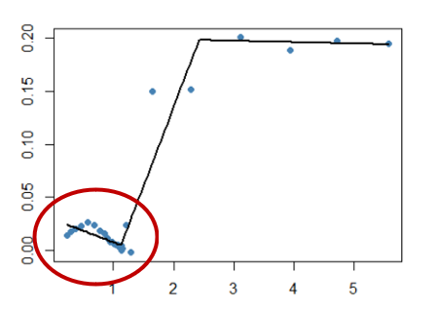
 |  | Ambient pCO₂ | Moderate pCO₂ | High pCO₂
Embryos | Exp. 1 (24°C) | 10% | 22.22% | 11.11%
 | Exp. 2 (22°C) | 18.18% | 16.67% | 35.71%
2dph Larvae | Exp. 1 (24°C) | 100% | 90% | 77.78%
 | Exp. 2 (22°C) | 66.67% | 83.33% | 53.85%
5dph Larvae | Exp. 1 (24°C) | 55.55% | 37.5% | 33.33%
 | Exp. 2 (22°C) | 85.71% | 40% | 75%
Oxygen consumption sometimes peaked in low oxygen, possibly due to stimulation from lactate buildup.
Embryos were often oxyconforming for entire trial (<5 mg/L).

Slide 21
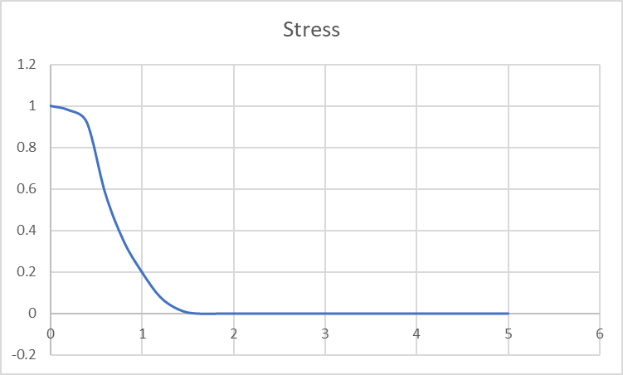
Asymmetric curve for additional stress at very low oxygen
Steeper increase in stress to near maximum when the low-oxygen MO2 spike occurs (red arrow).
This brings stress near the maximum until oxygen reaches zero.
Asymmetric logistic or sigmoid curve (e.g. shape of allosteric sigmoid function)
OR could have two stress functions, each to a different parameter and representing a different source of stress (being below Pcrit vs. having lactate accumulate).

